Slide 1

Descriptive Statistic
Zain

Slide 2
IPL Analysis
Now that this year's IPL is over, let's not curb our cricket love and start analyzing the whole of IPL with this latest and complete Indian Premier League dataset. It contains the match descriptions, results, winners, player of the matches, ball by ball dataset and much more. So, stop thinking and start analyzing

Slide 3
Aim
To analyze Data
To find anomalies
To preprocess data
To cleanse the data
To provide the insights on data with different visualization

Slide 4
Case
To provide detailed insight on IPL in various dimensions like
Date/month/year
Venue wise
Player wise
Team wise

Slide 5
Audience
Cricket Board Members
Team Owners
Brands
Marketing companies

Slide 6
Nature of Data
We have data in Vaccination details
Match wise
Ball by ball detailed data
Around 192879 records ,mainly 5 categories , few discrepancies detected like (null values , duplicate values , around 9 numerical variables which are contentious

Slide 7
Visual Insights – Top winners
Top 5 Teams

Slide 8
Visual Insights - Leading batsman
Top Batsman – V Kohli

Slide 9
Visual Insights - Wickets
Malinga – highest wicket taker

Slide 10
Visual Insights - Total matches
Royal challengers has played highest
Number of matches

Slide 11
Visual Insights - Count of matched
Highest number of matched played
In 2013

Slide 12
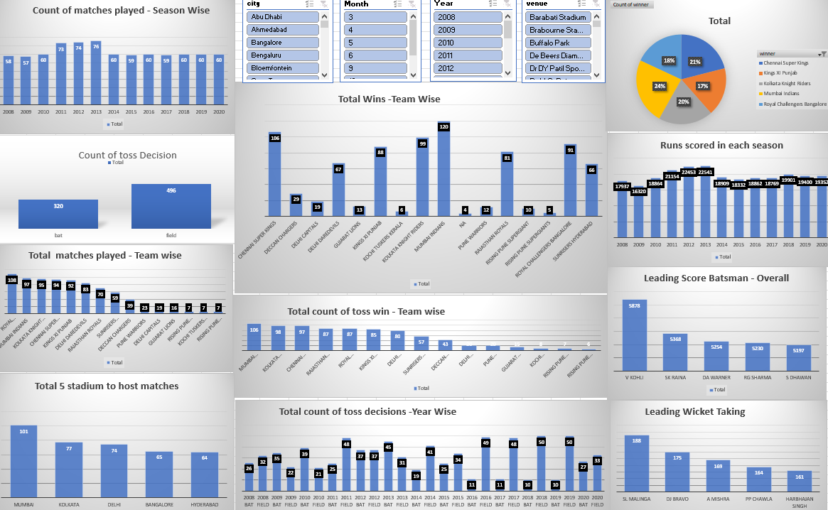
Visual Insights - Overall

